Slide 1
Treasurers’ Association of Virginia
Howard Overbey
Tax Processing Manager
June 13, 2017

Slide 2
TOPICS
Changes to Personnel
Interest Rate Changes
New TAX Website and logo
New electronic payment requirement for some
individual income taxpayers
Electronically Filed Local Estimated Payments

Slide 3
Changes to Personnel
Carol Herring has retired
Bertha Baskerville has assumed the majority of Carol’s role
including keying to Cardinal, handling uncollectibles, etc.
Lisa Greene is Bertha’s supervisor
Lynn Pulley-Paine continues as our local estimated subject
matter expert
Keven Wright is the new Local Liaison replacing Jay Doshi

Slide 4
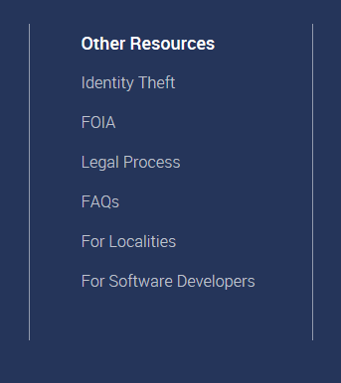
TAX Website: New look and logo

Slide 5
Interest Rate Changes
Communicated via Gov.delivery in the form of a
“tax bulletin” every quarter
Interest rates are also published on the locality
website
Interest rates are automatically updated in the
IRMS Penalty and Interest Calculator as changes
occur

Slide 6
Penalty and Interest Calculator
Refer to Chapter 12 of the IRMS User Guide for
Localities for detailed instructions.
The IRMS User Guide for Localities may be
referenced in Locality TARP at
www.locality.tarp.tax.virginia.gov

Slide 7
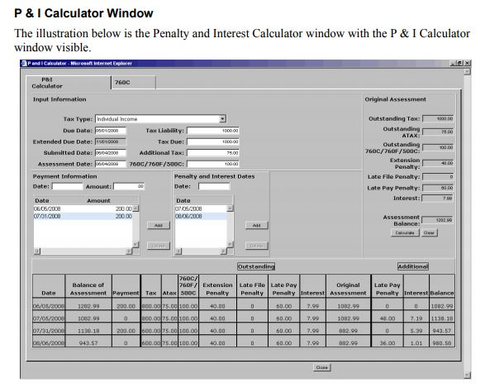
Penalty and Interest Calculator

Slide 8
Penalty and Interest Calculator
The Penalty and Interest amounts calculated will depend on the information
entered for each of the following variables:
Specific tax type
Amount of the tax liability
Submitted date of the return
Due Date of the filing period
Penalty and interest effective date
Amount of tax due
Payment information

Slide 9
Penalty and Interest Calculator
Once information is entered, IRMS verifies the information and calculates
penalty and interest.
If required information is missing or incorrect, the system will prompt
re-entry or correction of specific entries

Slide 10
Electronic Filing / Payment Mandate for Certain Estimated Payments
During the 2017 Session, an electronic filing and payment amendment to
the 2017 Appropriation Act – Item 275(K)(1)(f) – was adopted
Requires taxpayers to file and remit estimated payments electronically if:
Any installment or extension payment exceeds $15,000 or
The taxpayer’s total liability exceeds $60,000 in a taxable year

Slide 11
Electronic Filing / Payment Mandate for Certain Estimated Payments
Virginia Tax recently sent letters to taxpayers who meet this requirement
effective with the estimated payments due June 15, 2017
Virginia Tax website homepage https://www.tax.virginia/gov/
If local offices receive estimated returns or payments that are subject to
the electronic mandate
Accept them as in the past
If possible notify the taxpayer of the new requirement

Slide 12
EESMC – Local Estimated Payments
Process of converting from paper to electronic
began on July 1, 2015
Majority of Treasurers have converted
EESMC plus conversion to Cardinal has enabled us
to discontinue estimated advicing each month
(Announcement sent September 15, 2016)

Slide 13
EESMC – No more Advicing
You will now be able to reference our Cardinal entries and compare them to each of your deposit certificate collection totals for balancing purposes at the end of each month on your RAR721 Report
If you find that you are out-of-balance, my staff (Bertha Baskerville) will assist you in the same way she would have, had you been presented with an advice

Slide 14
Missing Estimated Payments
Gov.delivery announcement was sent March 8, 2017 alerting local offices
about this problem
File Issues Identified:
Estimated payment data files transmitted to TAX electronically by the
Treasurers’ offices rejected, in many cases, but were not corrected and
resubmitted for handling
Data files were not transmitted
Once a deposit is made, it is imperative that the accompanying estimated
data file be transmitted to TAX and traced until the file fully processes

Slide 15
Locate Your Messages
Secure Message Communications in EESMC:
Local estimated files uploaded to TAX’s secure server during the day are generally
submitted for processing that night
If a file rejects, a rejected error file notification is sent to the individual who
originally uploaded the file. The notification should be reviewed in that
individual’s EESMC “Inbox”
If the secure message is not opened or viewed by the recipient within a specific
timeframe, a reminder email is automatically sent to the individual who uploaded
the file regarding the rejected file
Please refer to page 7 in TARP’s EESMC User Guide for explanation regarding how to
access these EESMC messages

Slide 16
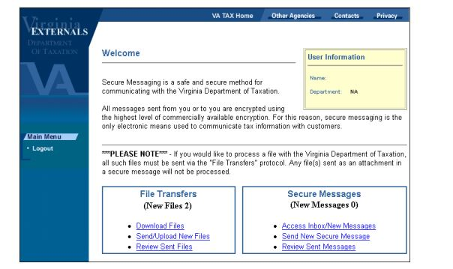
Check Every Day

Slide 17
Check the 291.0 Report
Weekly report
Lists every EESMC file which has been uploaded the
previous week (Tab 1) as well as each file that was
returned to your office with errors (Tab 4)
Use this report to make sure you have a file that
corresponds to each of your deposits

Slide 18
Check your 56.0 Report
Weekly report
Shows Deposit Certificate detail from fully processed files which includes
Deposit Certificate Number
Deposit Certificate Amount
Number of Vouchers associated with the DC
Tax Year associated with the Deposit
Use this report to verify that every file on the 291.0 report (tab 1) is
included on the 56.0 as evidence of a fully processed file

Slide 19
Check IRMS Taxpayer Payments
Once a file fully processes, each of the taxpayer
accounts on the file will be updated in IRMS
Your office may review IRMS at any time to
determine if these payments have posted

Slide 20
Send Us Your Transmittals
Once you make your deposit and successfully upload the associated file,
send your transmittal to TAX via email or fax
As a precaution, to eliminate the possibility that EESMC files are not fully
processed, we will not key transmittals into Cardinal (the Financial
Certification System) until we see that the associated deposit certificate
appears on the 56.0 report
This will ensure that TAX’s records are in balance with DOA’s records and
protects the taxpayer from erroneous billings and confusion associated
with “missing” estimated payments

Slide 21
EESMC - TIPS for Rejected Files
Troubleshoot files when the associated Deposit Certificate is not shown on the 56.0 report
Generally, the root cause is commonly one of the following:
File was fully processed after the report was generated
Check the next week’s report
File was not uploaded
Use the 291.0 report, 1st tab “Incoming Estimated Payments” to determine if the file was submitted
If the file is not listed, the file was never submitted!
If the file is listed, then there may be an error
File did not successfully process due to an error
24 -48 hours after submission, log into EESMC and check your “Inbox/New Messages” for the
failed upload error message
The associated Error message(s) are also shown beside the file listed on the weekly 291.0 report,
4th tab “Returned Files”

Slide 22
Problems?
Do you need IRMS training?
External.Entity.DocForms@tax.virginia.gov
Problems with Receiving reports?
Irms.support@tax.virginia.gov – TAX’s IRMS Support personnel can review the distribution list for your office and advise you on what you need to do

